Slide 1
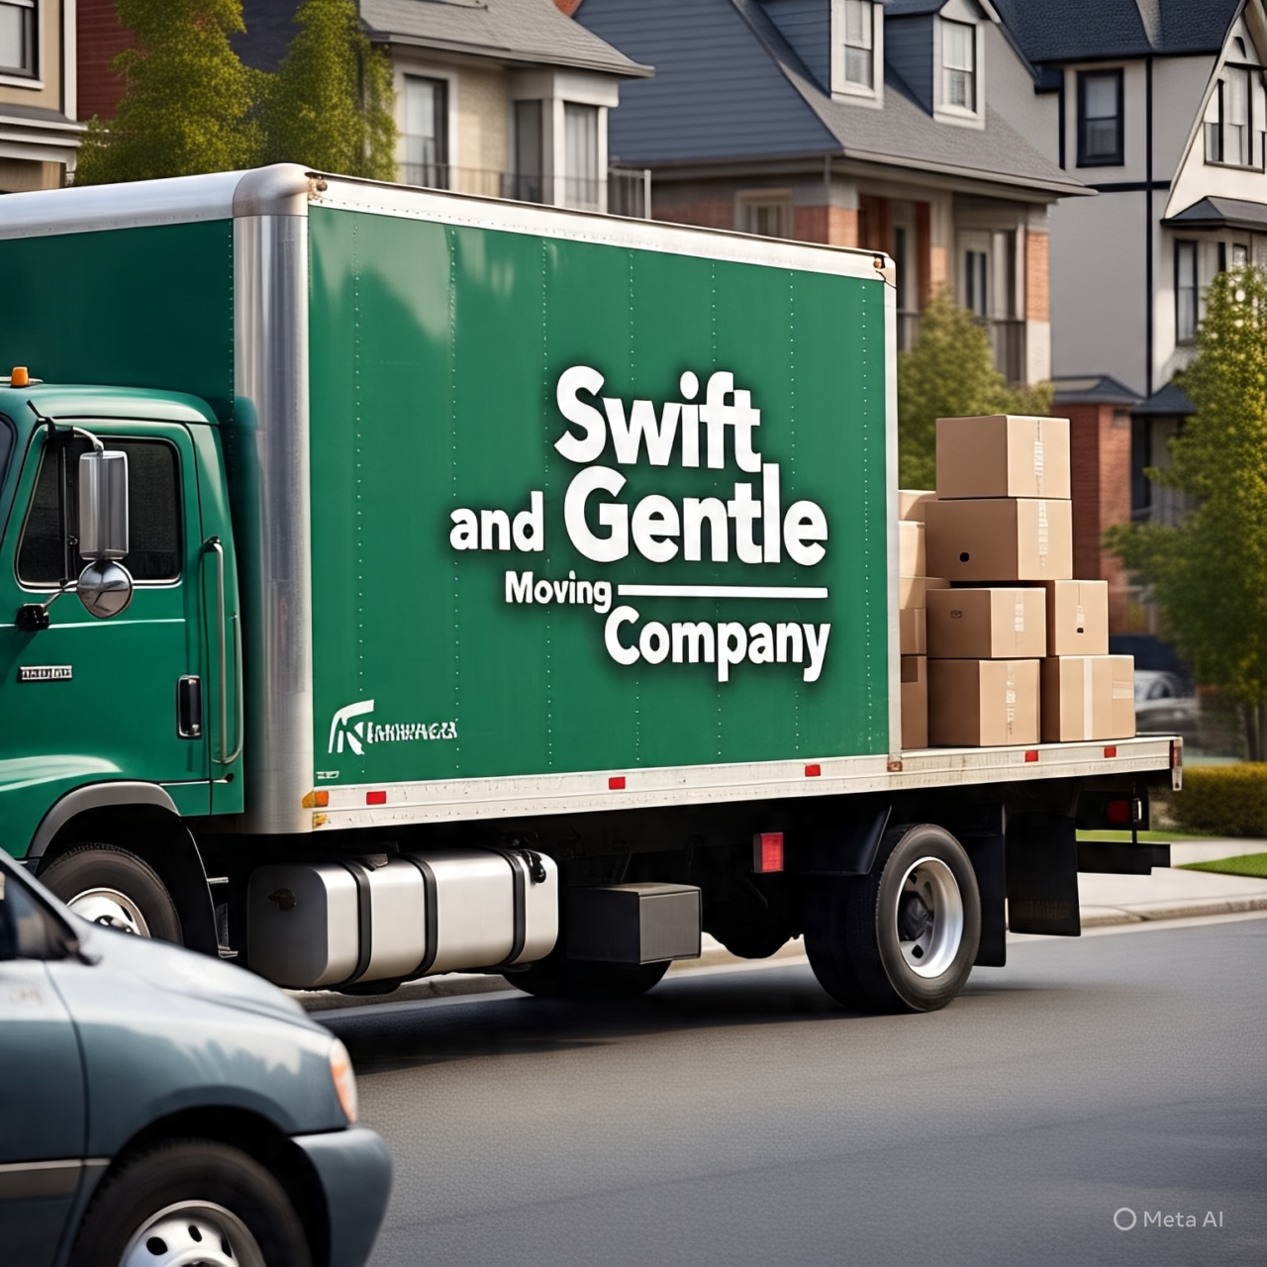
Personalized Chatbot Solution for SWIFT&GENTLE

Slide 2
History of Chatbots in Customer Service
Early chatbots were simple and rule-based
Modern chatbots use AI and machine learning to provide more personalized experiences
Chatbots are increasingly being used in customer service to improve efficiency and reduce costs

Slide 3
Future Potential of Personalized Chatbots
Improved customer experience
Increased operational efficiency
Enhanced personalization
Potential for increased customer loyalty and retention

Slide 4
Current Software Solutions for Moving Companies
HubSpot
Constant Contact
Birdseye
Freshdesk
Zoho CRM
Salesforce

Slide 5
Real-World Applications of Personalized Chatbots
Customer service and support
Lead generation and qualification
Scheduling and booking
Providing personalized recommendations and solutions

Slide 6
Design Approach
User-centered design
Natural language processing (NLP)
Machine learning and AI
Integration with existing systems and platforms

Slide 7
Solution Design Proposal
Personalized chatbot interface
NLP and machine learning capabilities
Integration with existing systems and platforms
Customizable and adaptable to meet specific needs of moving companies

Slide 8
Open Questions
How can we ensure that the chatbot is able to learn and adapt to customer needs effectively?
What are the potential challenges and limitations of implementing a personalized chatbot solution in the moving industry?

Slide 9
Citations
Here are the sources I used in my research. I have cited all sources
Gartner. (2020)
Conference paper: Johnson, K. (2019).
Journal article: Smith, J. (2020)
Swift and Gentle .com

